Slide 1

UT Coding Bootcamp
UTA-VIRT-BO-FSF-PT
Instructor: Richard Hosek
Fall 2020
Group 3:
Auto-Tracker Application
Richard Ay
Owais Islam
Lorena Kell
Cameron Wills

Slide 2

Auto-Tracker – Data Safe
Families and Organizations with multiple vehicles acquire time-sensitive data related to the drivability of each vehicle.
Registration expiration.
Insurance expiration.
Mileage of the last tire change..
Failure to keep track of this data can lead to fines or unsafe driving conditions.
The Auto-Tracker keeps all of this data in a single web-based repository and eliminates the need for physical notes – prone to loss.
Notes:
This is the ‘elevator pitch’ – why this application is needed.
A single repository of auto data prevents important lapses.
Eliminates the need for paste-notes on walls/refrigerators.

Slide 3
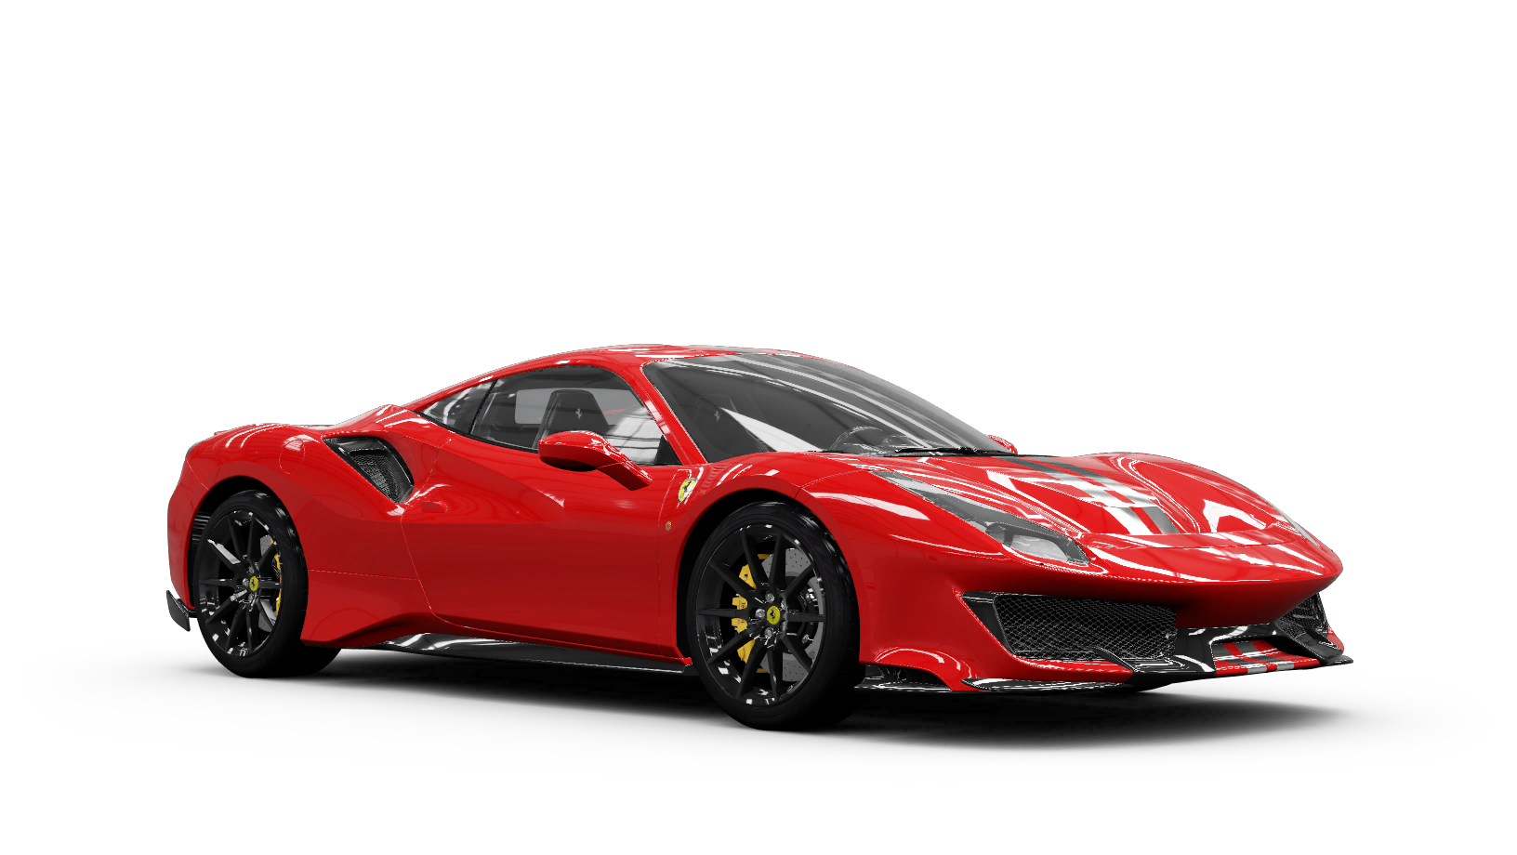
Auto-Tracker – The Concept (User Story)
As the owner of several vehicles, I want an application that can track:
(License plate) registration renewal dates.
Insurance expiration dates.
The VIN number.
The toll tag number.
The mileage of the last tire change.
The mileage of the last oil change.
The mileage at the time of purchase.
The primary vehicle driver.
In using the application, I want to:
Be able to add drivers.
Be able to add vehicles
Use the app from any device.
Notes:
The user story.
Vehicle: Ferarri 488 Pista

Slide 4
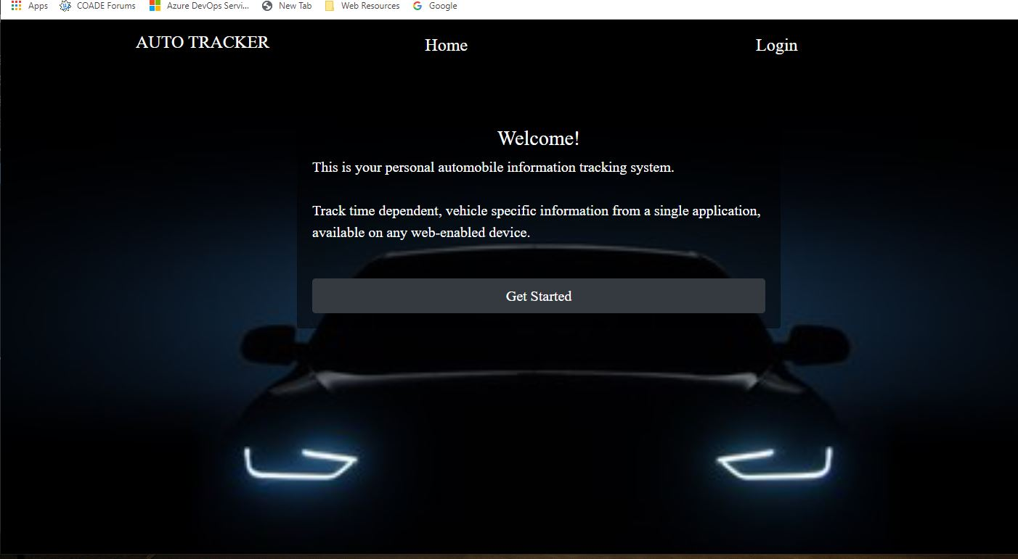
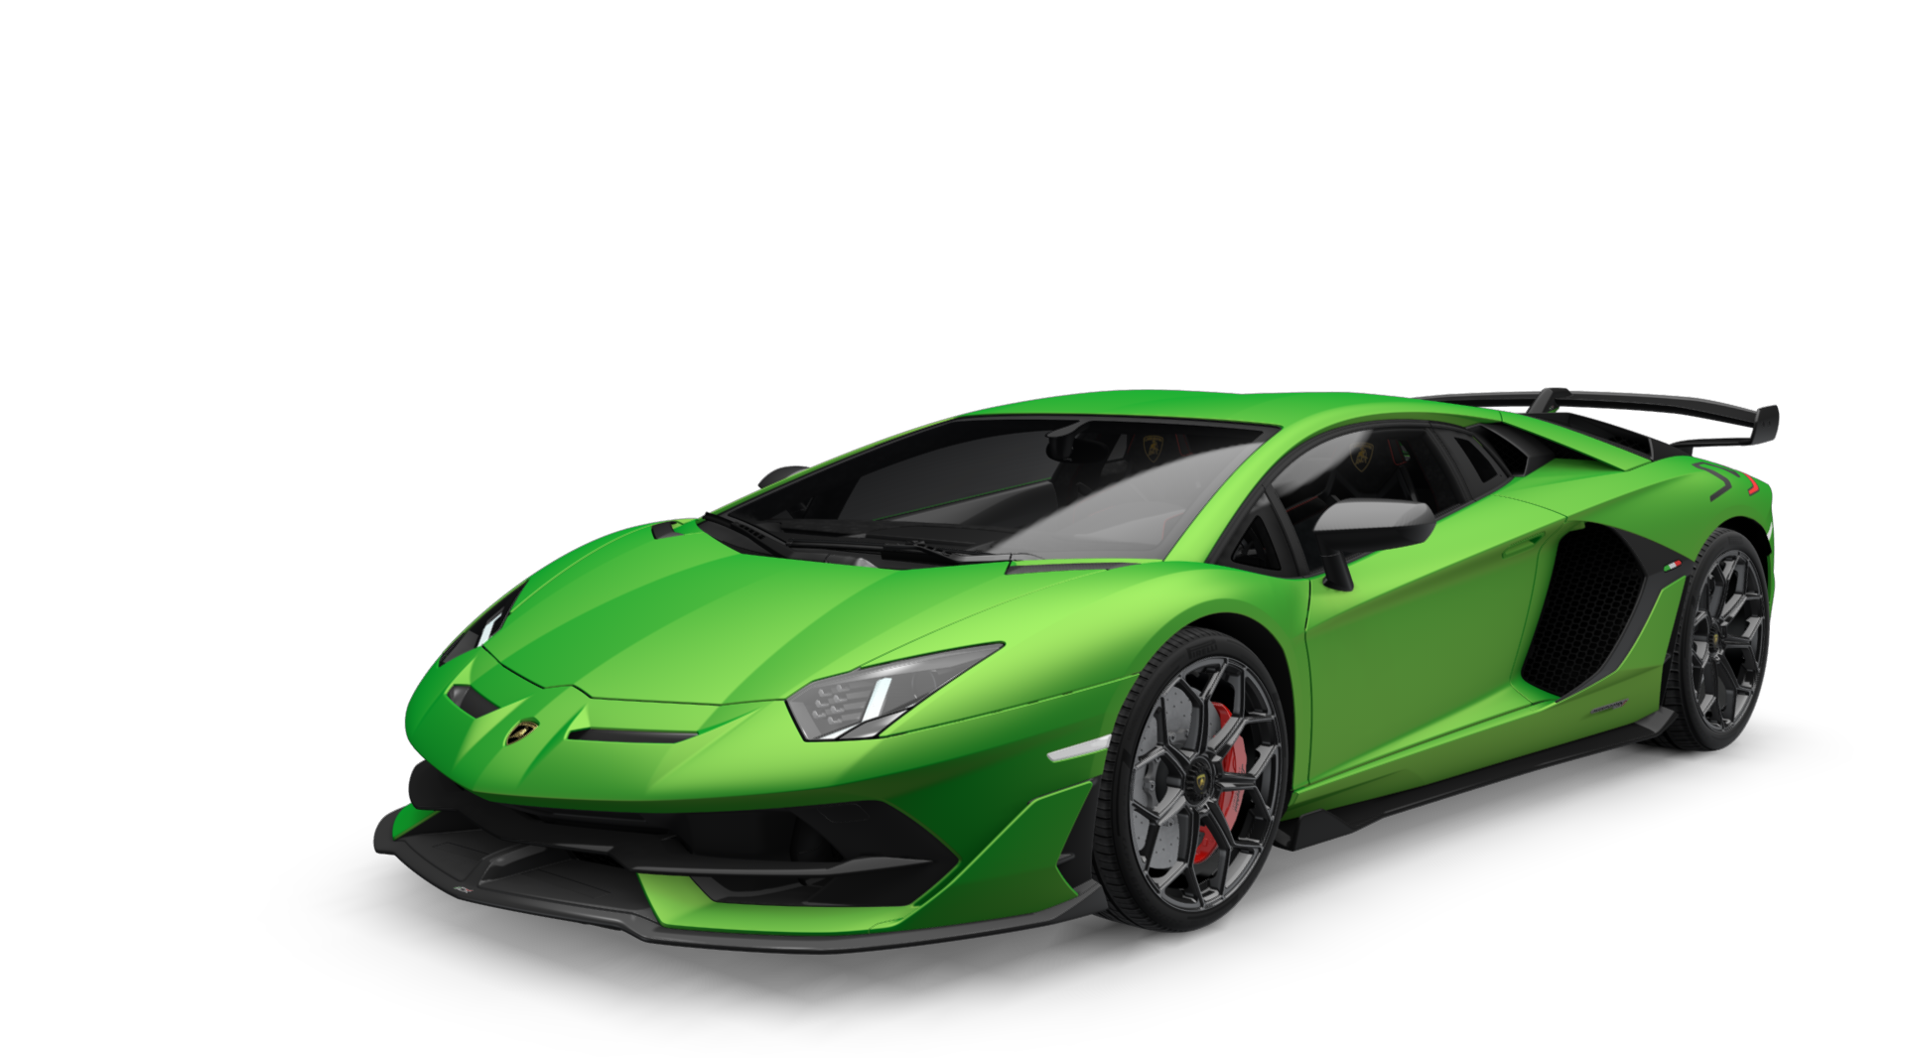
Auto-Tracker – The Concept, Details
The application is based on the MVC architecture.
The application stores data in an SQL database.
Routes are available for complete CRUD operations.
Once the owner/user signs up, all other operations are available.
Owners can add, and view vehicles and drivers.
Notes:
A description of what the application does.
The motivation for development is to always have vehicle information readily available.
Vehicle: Lamborghini Aventador SVJ

Slide 5
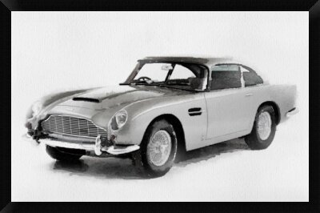
Auto-Tracker – How it Works
The application utilizes the following new technologies to upload images:
AWS S3.
Multer.
Multer S3.
Challenges & Success:
A responsive application.
Great peer/pair programming,
Challenging use of modals.
Challenging implementation of image upload
Project roles and work split.
Cameron laid out the application structure and framework, built the frontend, as well as the CSS and modals.
Owais setup the routes, editing functions, and session authorization.
Rich laid out the concept, the documentation, and worked on the handlebars, routes, and modals.
Lorena handled research and helped during pair programming sessions.
Everyone contributed to coding (often in a group via Zoom). We used pair programming most of the time.
Notes:
Vehicle: James Bond Austin Martin D85

Slide 6
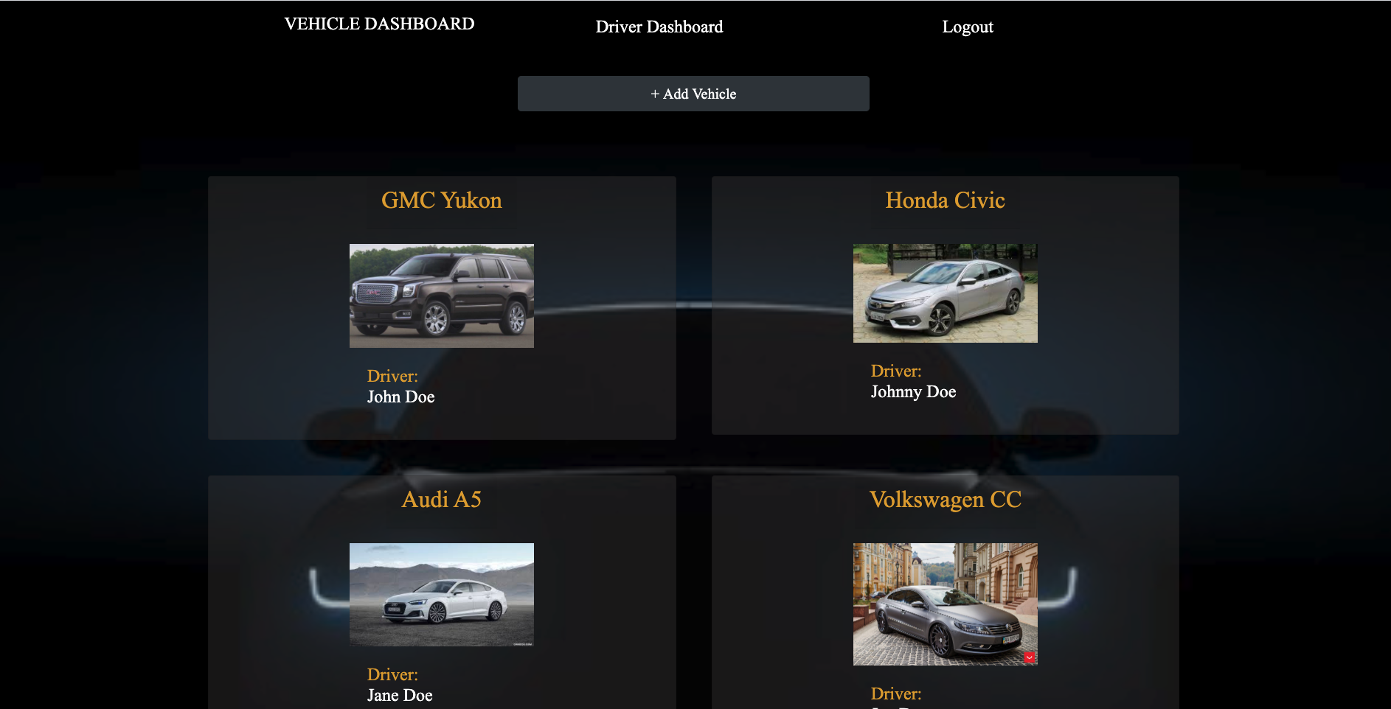
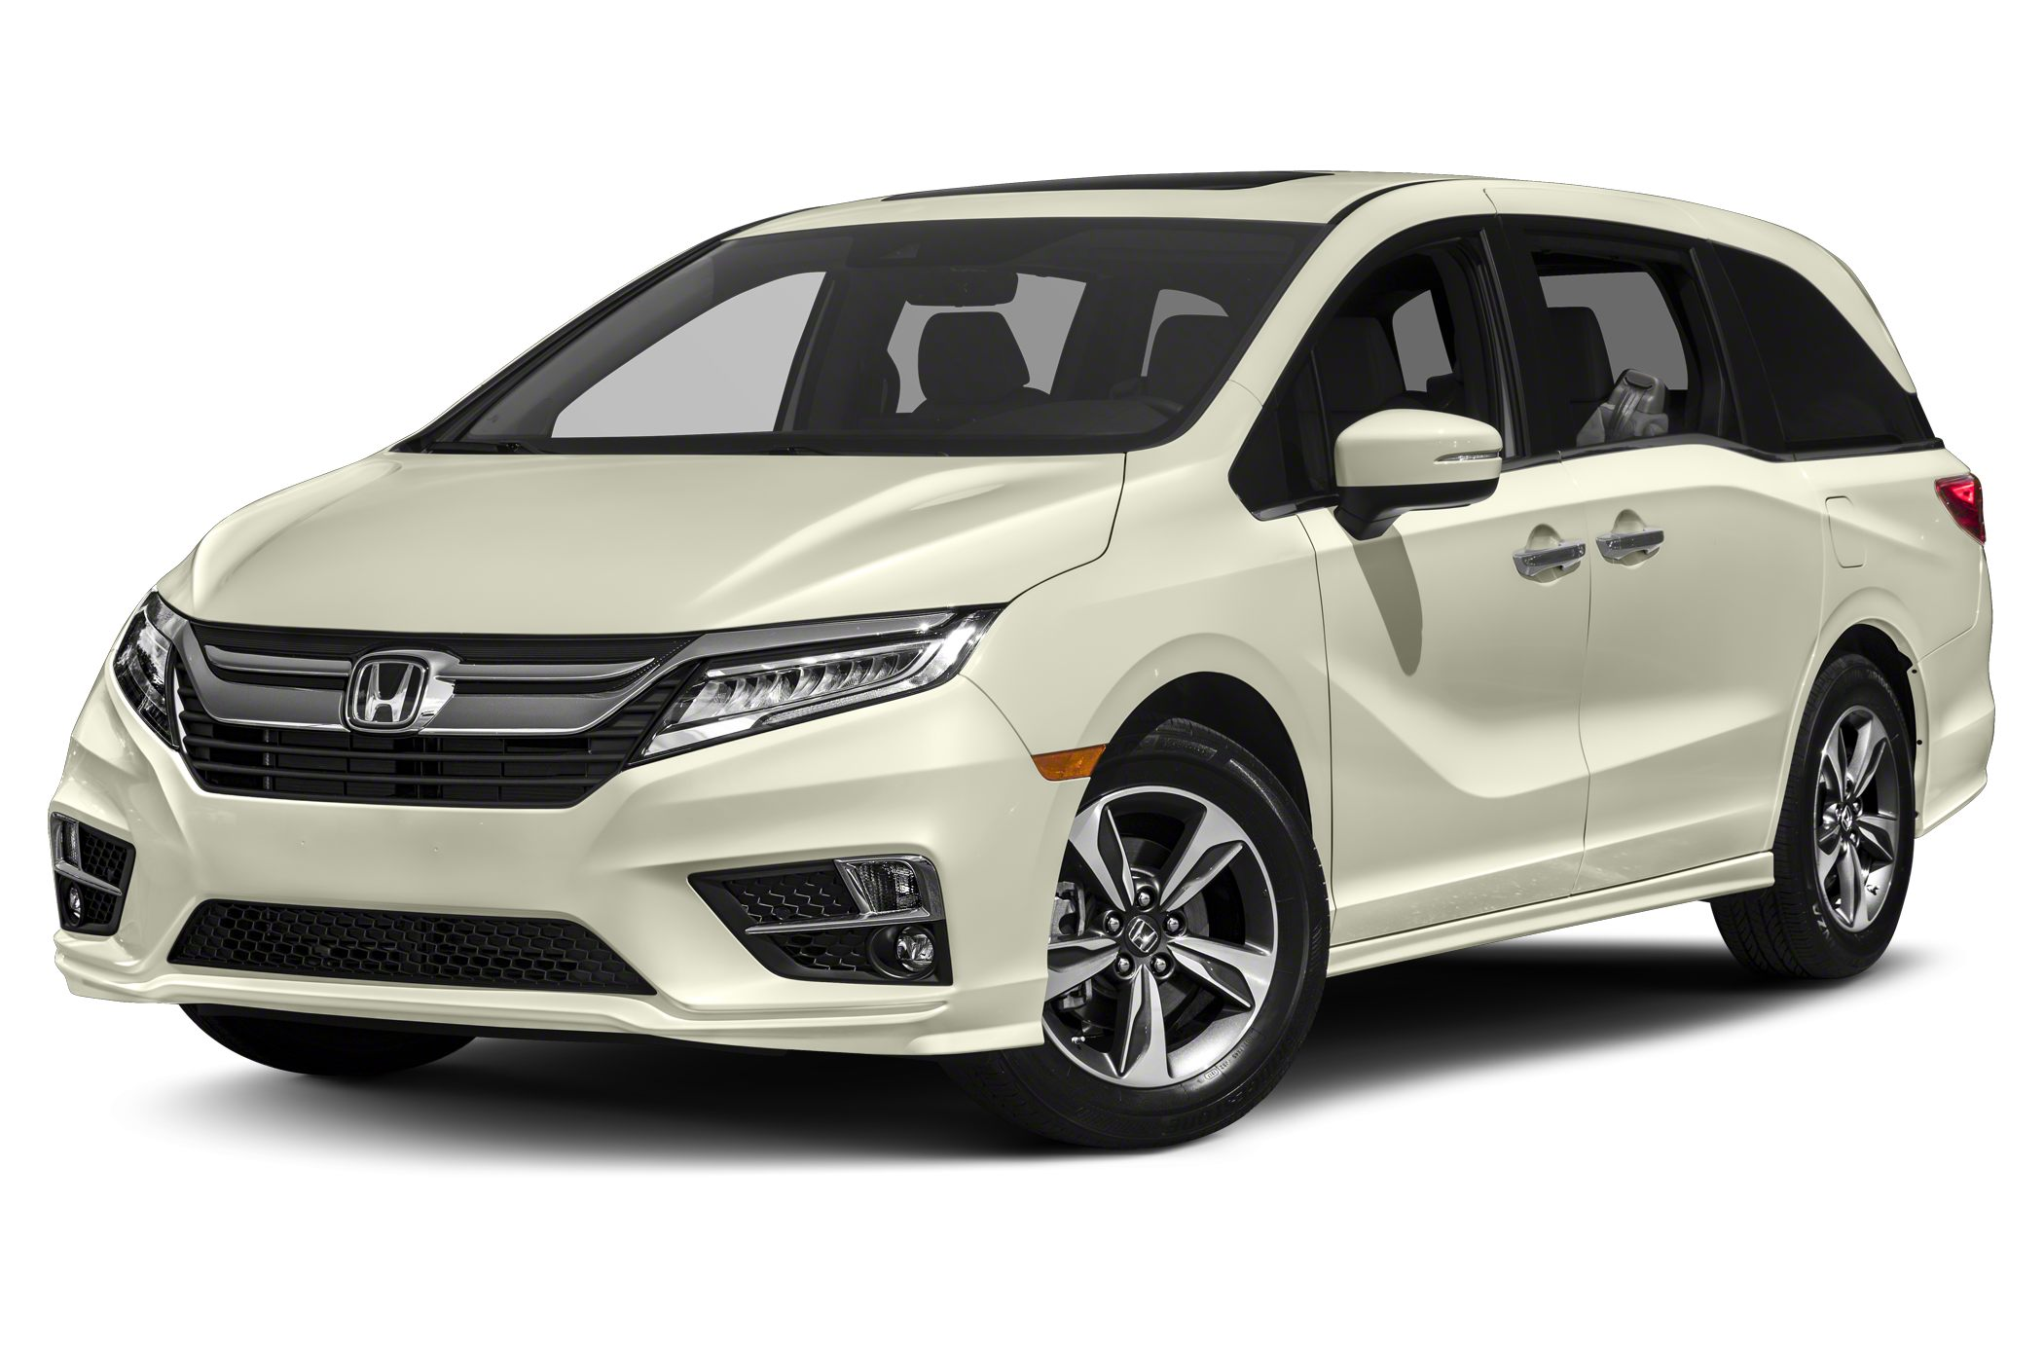
Auto-Tracker – Application Details
An owner/user would implement this application by:
Signing up.
Defining a number of authorized drivers.
Defining vehicle details.
Periodically review and update information as necessary.
Notes:
The process/execution flow through the application
Discuss how a user would use the application.
Vehicle: generic family van

Slide 7
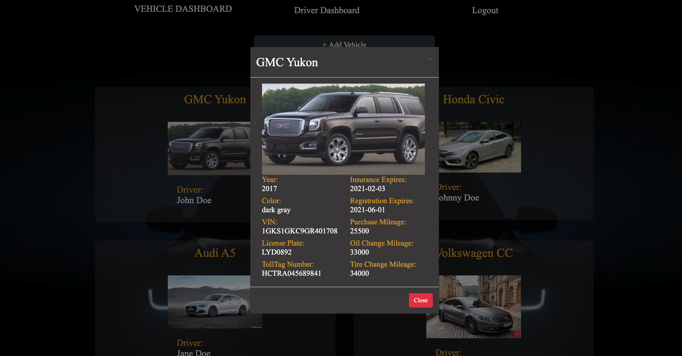
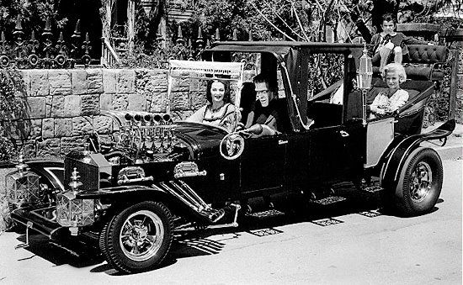
Auto-Tracker –Demonstration
The demonstration:
Run the application from Heroku.
Show the vehicle and driver dashboards.
Show detailed vehicle information, with updating.
Add a vehicle.
Notes:
A live demo of the application.
Vehicle: The Munster’s car

Slide 8
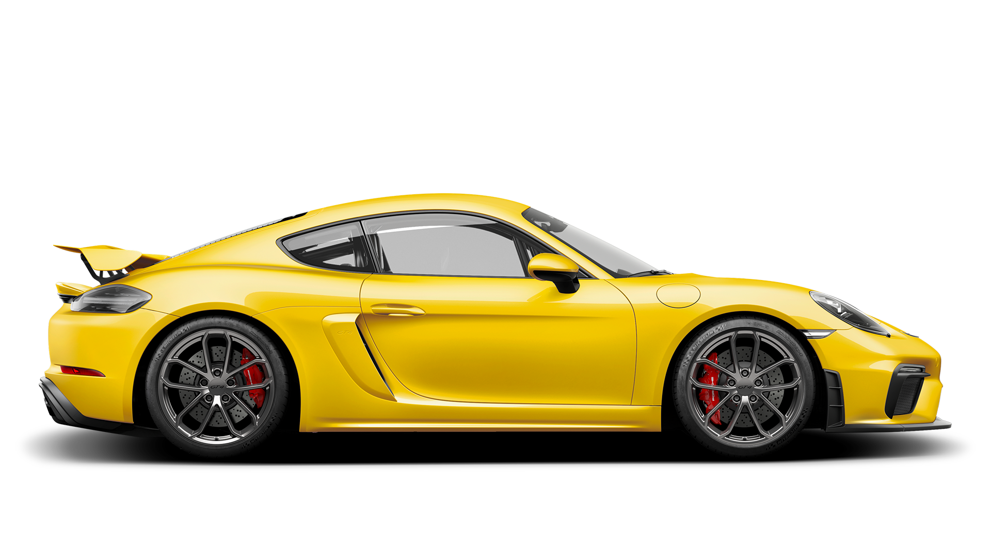
Auto-Tracker – Future Development
This application can be improved for the next version by considering.
Using a commercial application to acquire additional vehicle information.
Using a commercial API to acquire an image (picture) of the vehicle.
Owners be able to update and delete vehicles and drivers.
Have app go to Driver Dashboard first instead of Vehicle Dashboard.
Change date color when it is closer to the expiration date.
Add calendar functionality (pop-up calendar to select new expiration date)
Notes:
This slide discusses ideas and improvements that could be made in a future version of the application.
Vehicle: Porsche Cayman

Slide 9
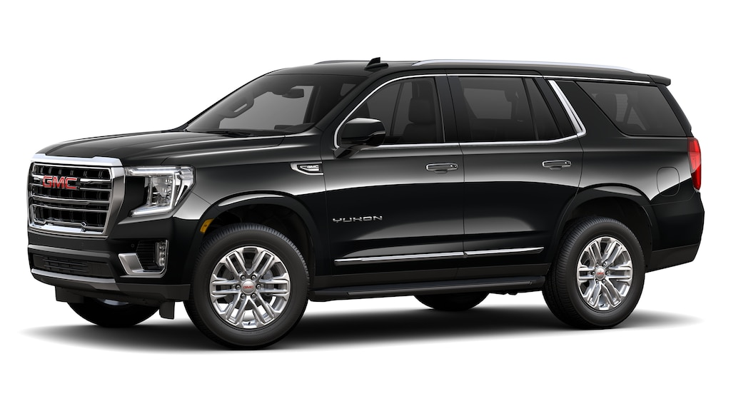
Auto-Tracker – Important Links
Link to deployed application:
https://team-3-auto-tracker.herokuapp.com/
Link to GitHub Repository:
https://github.com/p2T3/auto-tracker
Notes:
This slide shows the links to the “live” application on Heroku as well as the GitHub repository.
Vehicle: GMC Yukon XL

Slide 10

Auto-Tracker – Questions
Thank you for watching this presentation.
Questions ?
Notes:
Closing slide

